Slide 1
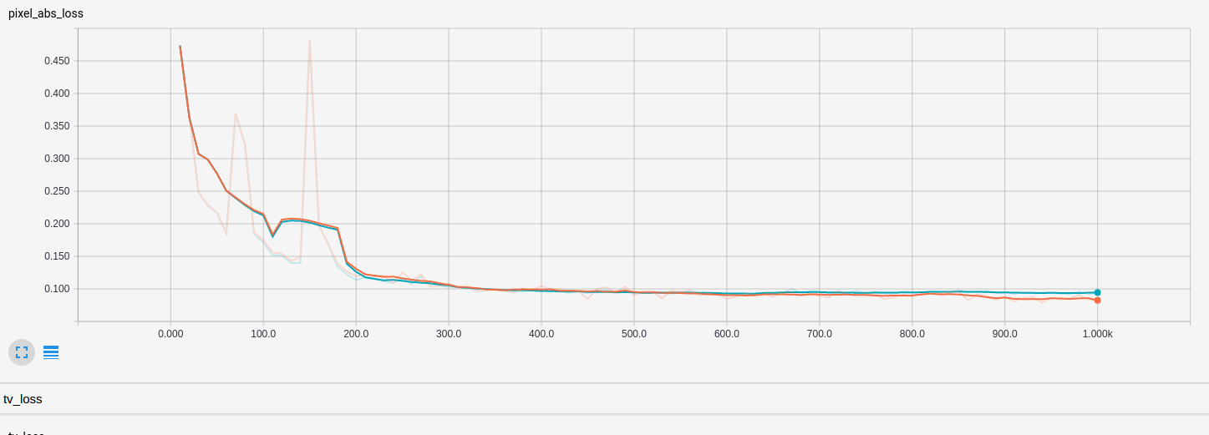
Train loss
Validation loss

